Slide 1
Beyond Civics 101: Students’ Civic Learning in a 21st Century World
Philip Sisson
Provost and Vice President for Academic and Student Affairs

Slide 2
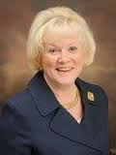
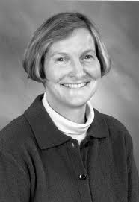
Where MCC has been…
Civic Learning Leadership
  Presidential Engagement
  Faculty Champions
Infrastructure and Partnerships
  Grants grew staff/support
    The Lowell Collaborative (LTC)
  Partnership recruitment and retention
  Technology tools

Slide 3
Where we are now…
Data:
  1100 Students
  24,000 service hours
  64 sections
  All academic divisions
Structure:
  Regular faculty training
  Noted on student transcripts
  Multiple models
https://www.middlesex.mass.edu/strategicplanning/downloads/fy14fb.pdf

Slide 4

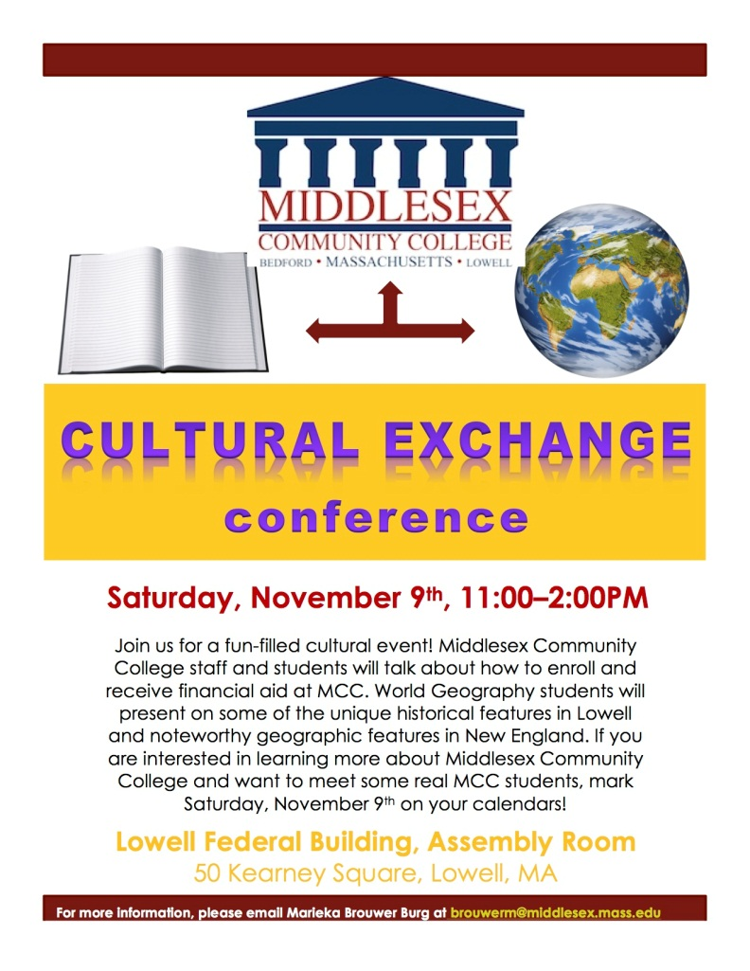
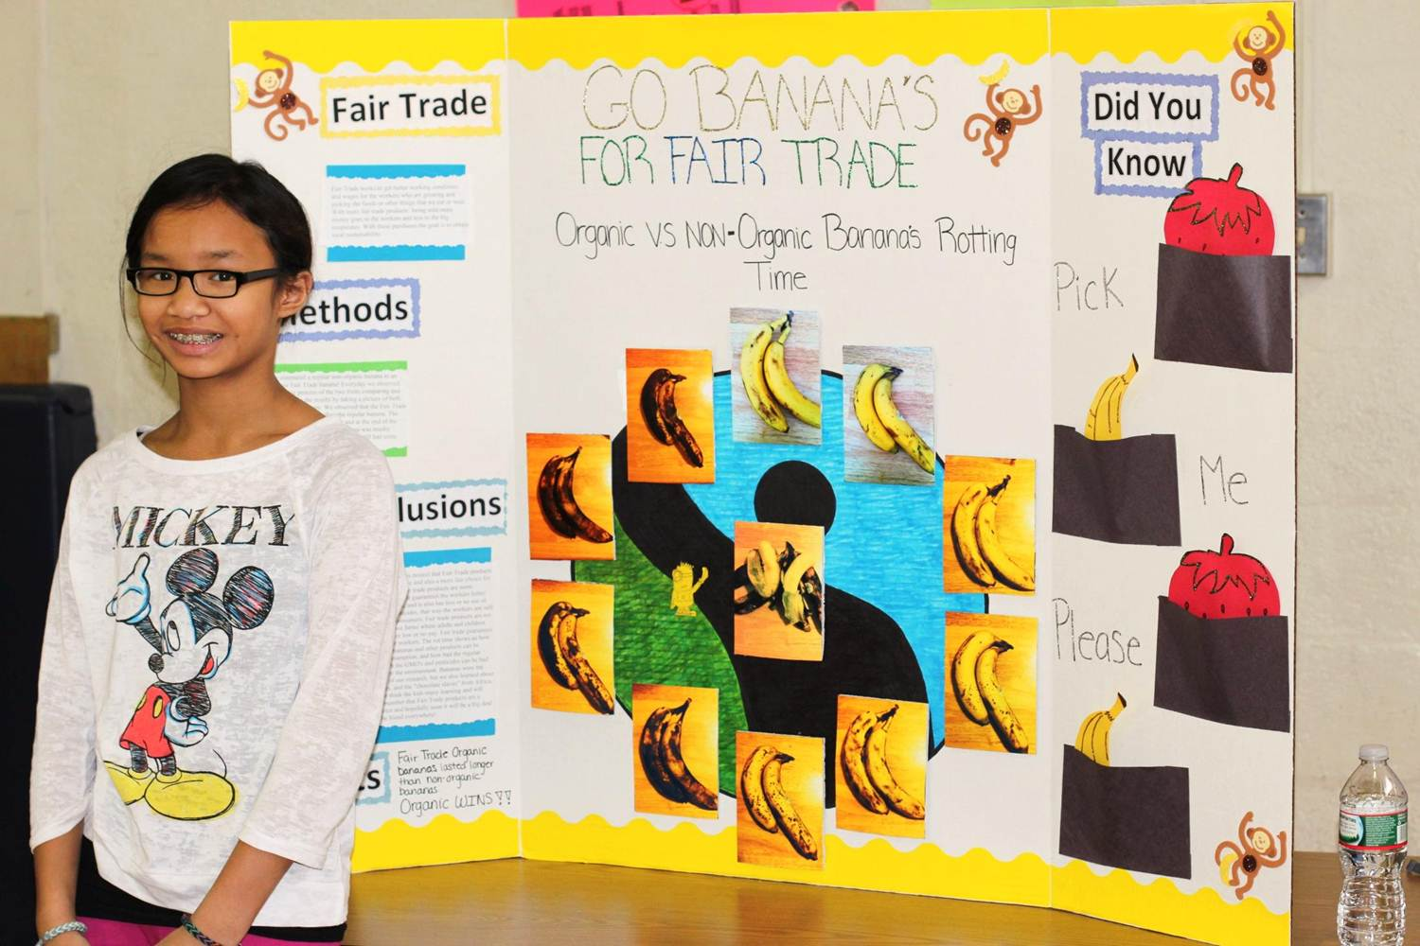
What we are building…
Global/Local Connections
Curriculum Design and Assessment Process
  ISLO’s
    Social Responsibility
    Multicultural/Global
    Personal/Professional
  IDS classes
  Alignment across institutions (K-16)

Slide 5






Valuable partnerships…

Slide 6
Phil Sisson
Provost and Vice President of Academic and Student Affairs
(781) 280-3571 sissonp@middlesex.mass.edu
Carina Self
Assistant Dean of Social Sciences and Service Learning
(978) 322-8408 selfc@middlesex.mass.edu
Cynthia Lynch
Director of Service Learning
(781) 280-3556 lynchc@middlesex.mass.edu

